Slide 1


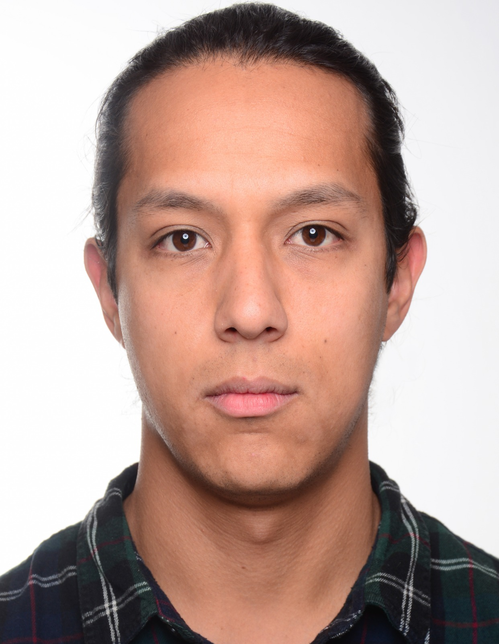



Collision monitoring for robotic manipulators
July 13th, 2020
Team Members: Alan Gomez, Samuel Parra, Brennan Penfold
Supervisor: Djordje Vukcevic

Slide 2
Project objectives
Create a collision monitoring library in C++.
Use the collision monitoring library to implement “Biologically-inspired dynamical systems for movement generation: automatic real-time goal adaptation and obstacle avoidance”, H. Hoffmann et al., 2019 [2].
Extend the implementation to avoid collisions between two manipulators.
Test the implementation with simulations.

Slide 3
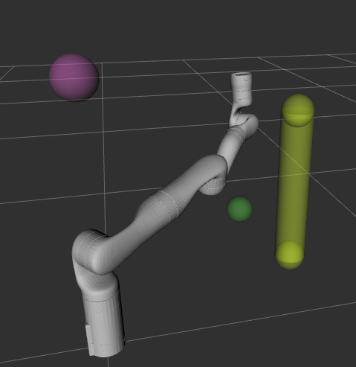
Collision detection and monitoring
The calculation of the distances between primitives considers the following cases:
Distance between two spheres
Distance between a sphere and a capsule
Distance between two capsules

Slide 4
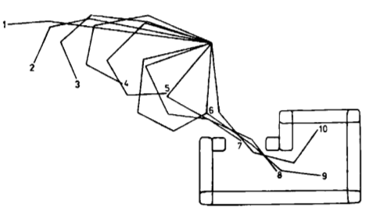
Real-Time Obstacle Avoidance for Manipulators and Mobile Robots, Oussama Khatib, 1986 [1].
Figure 1. Displacement of a 4 dof manipulator inside an enclosure [1].

Slide 5
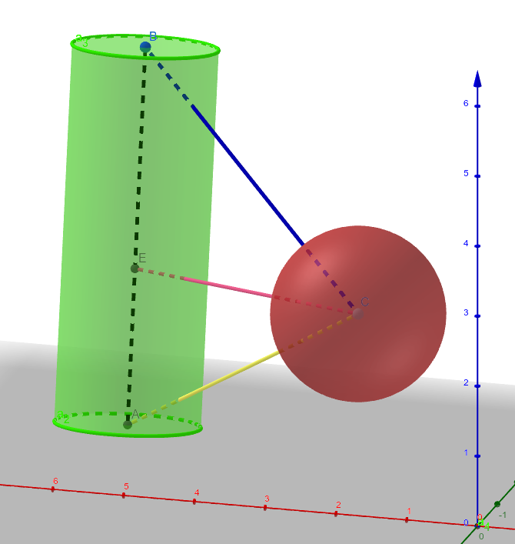
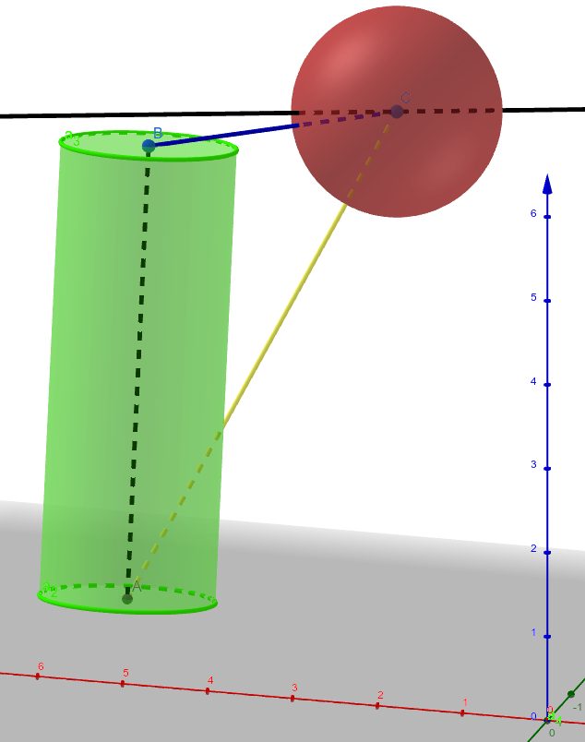
Distance between a sphere and a capsule
Figure 2. Distance between Sphere and capsule.

Slide 6
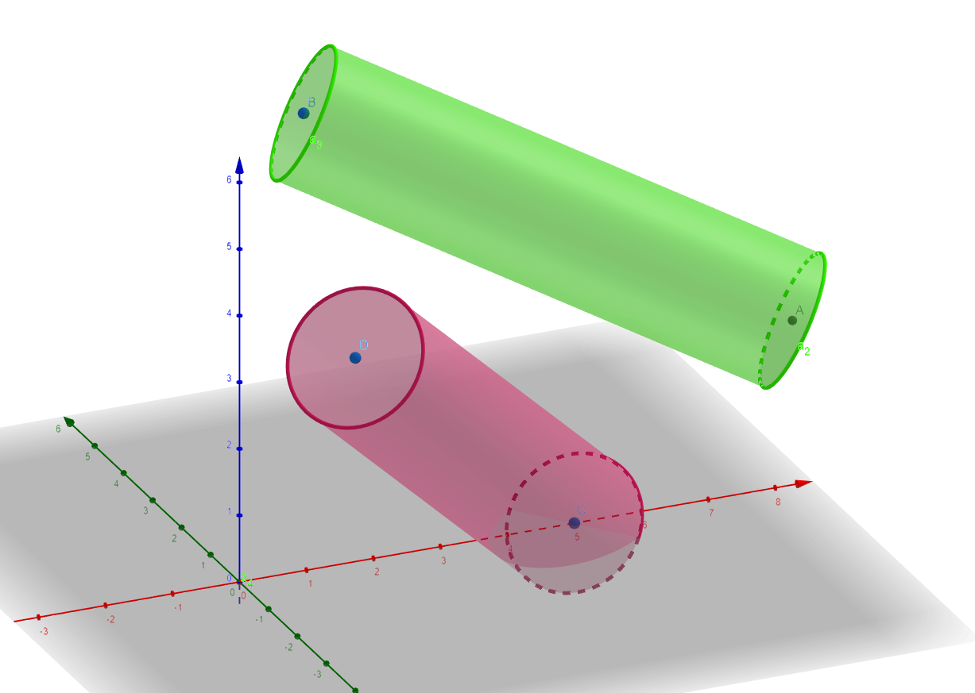
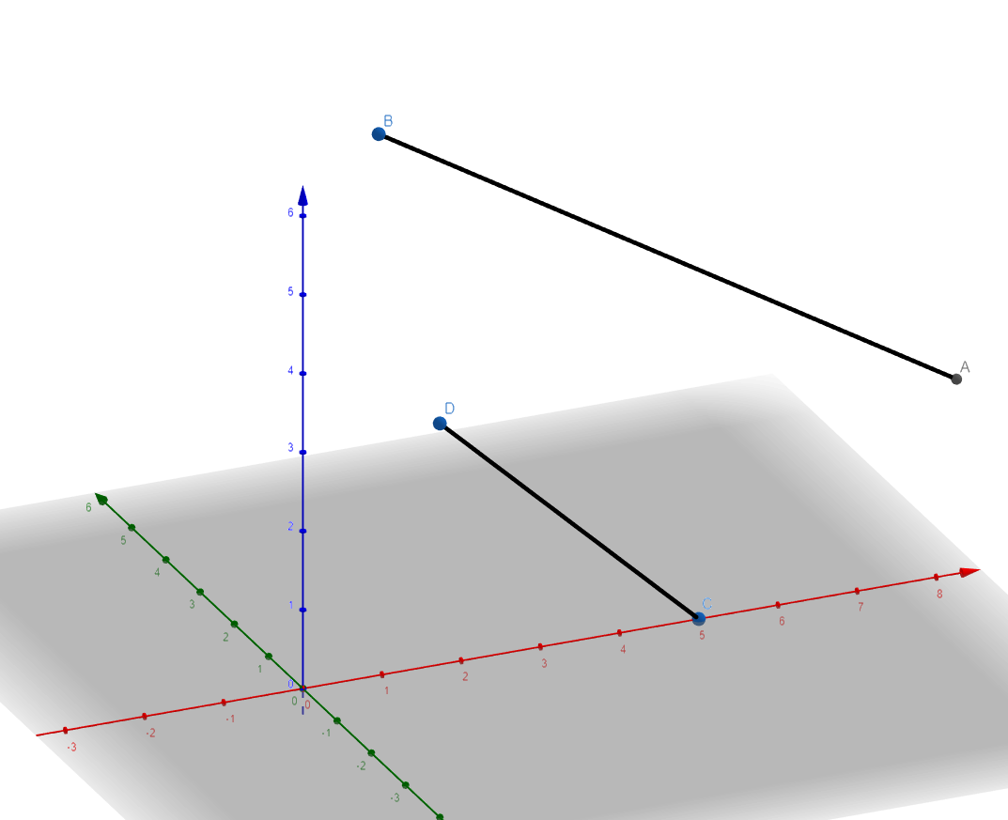
Distance between two capsules
Figure 3. Representation of two links as capsules.

Slide 7
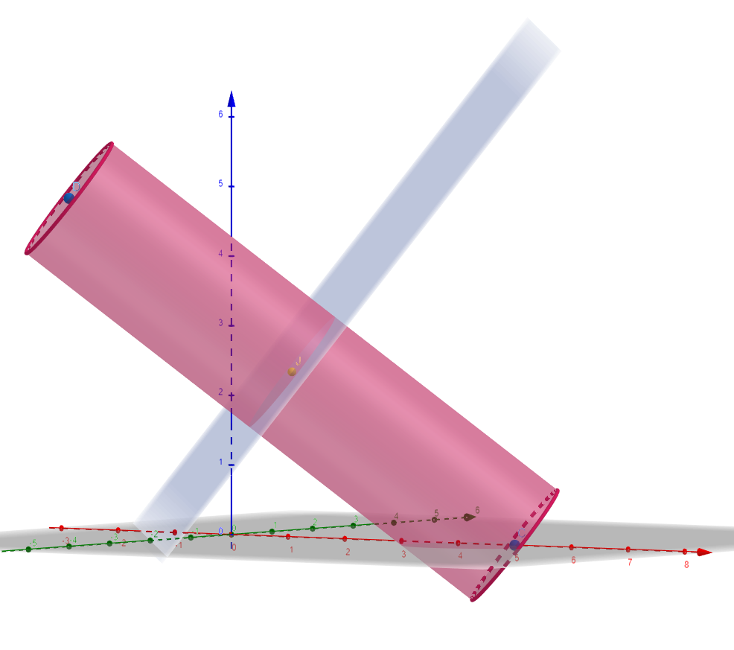
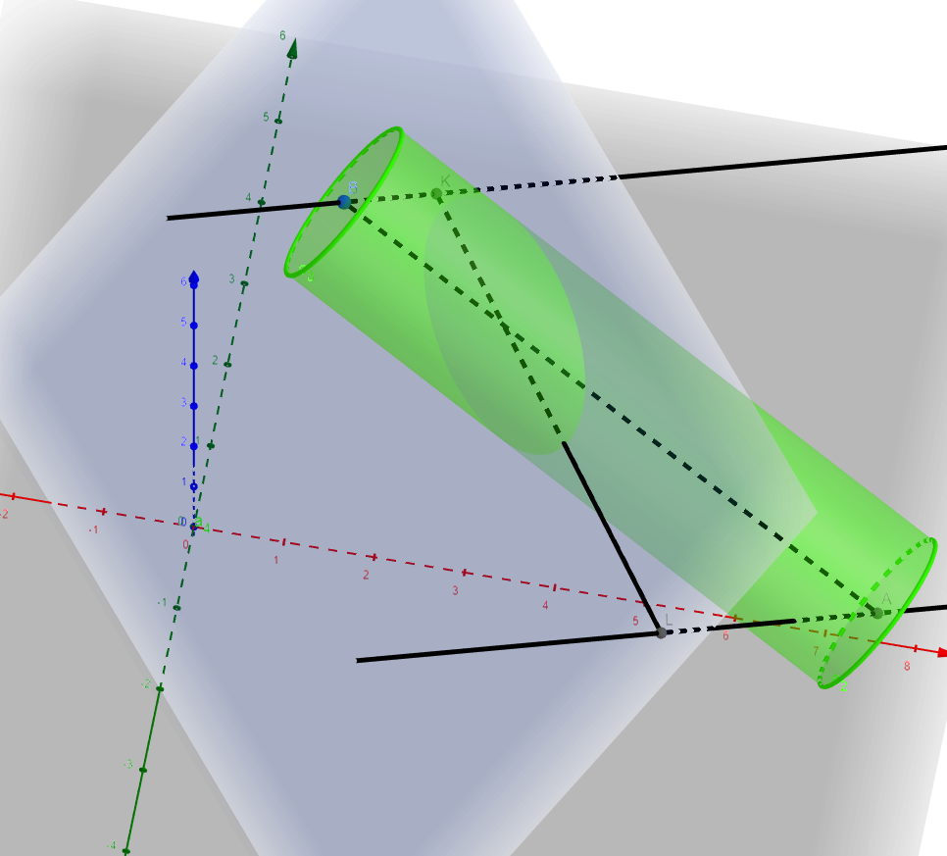
Figure 4. Reprojection of the second link onto the xoy plane of the first link

Slide 8
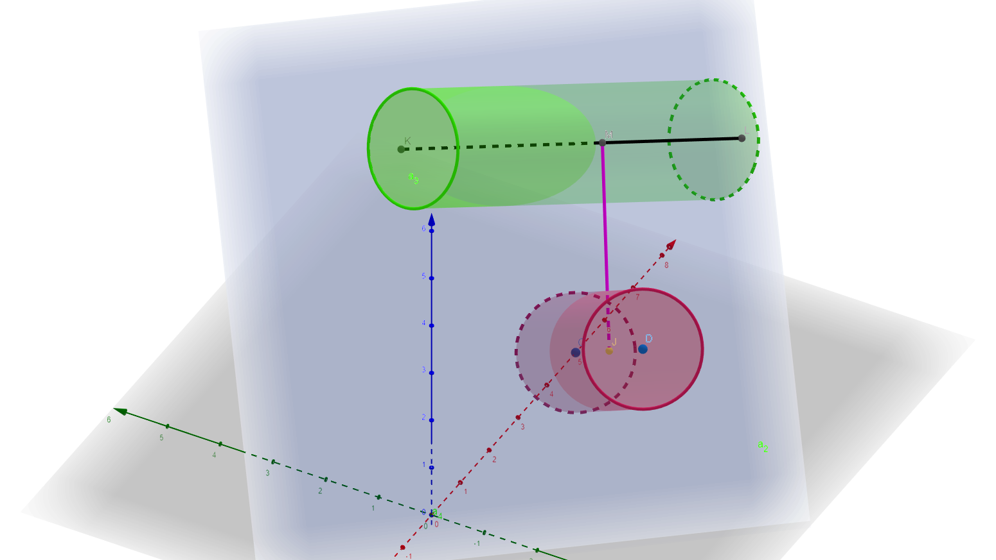
Figure 5. Final distance

Slide 9
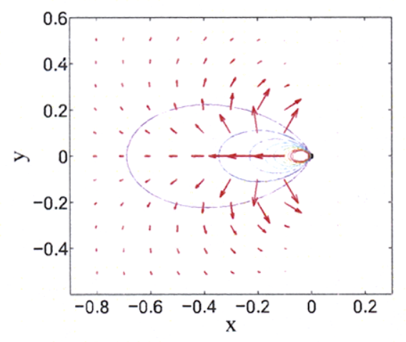
Potential Field Method
Idea:
Final result is the sum of many parts
Compared to other methods:
Traditional manipulator trajectory methods struggle with changing environments
Other techniques can produce unnatural or impossible movements
[3]

Slide 10
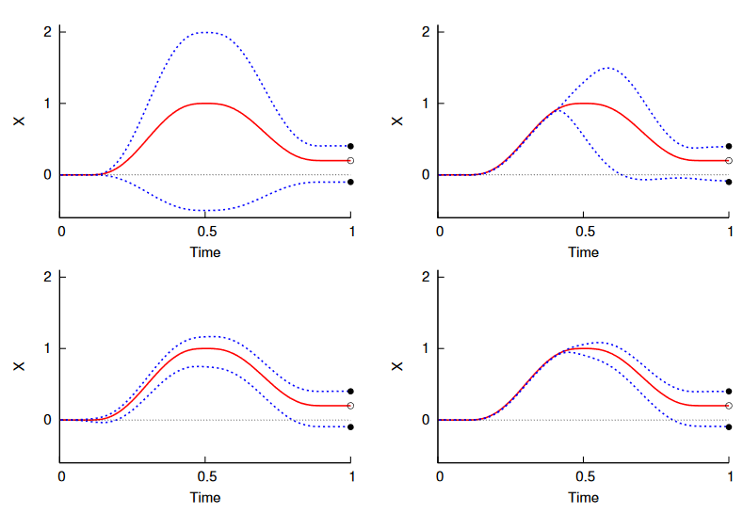
DMPs: Dynamic Movement Primitives
Advantages:
Any smooth movement can be generated with a DMP
Always converge to the goal point
Adapt to changes in goals
Differential equations are translation invariant
Duration of the movement can be controlled without changing the trajectory

Slide 11
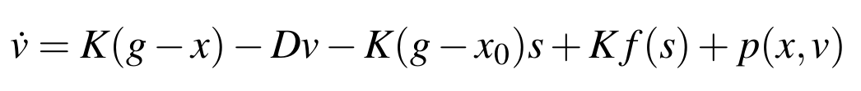
DMPs: Dynamic Movement Primitives
v = Velocity
K = Spring constant
g = Goal position
x = Current position
x0 = Initial position
D = Dampening factor
s = Phase variable
f(s) = Parameterized nonlinear function
p(x, v) = Obstacle avoidance function

Slide 12
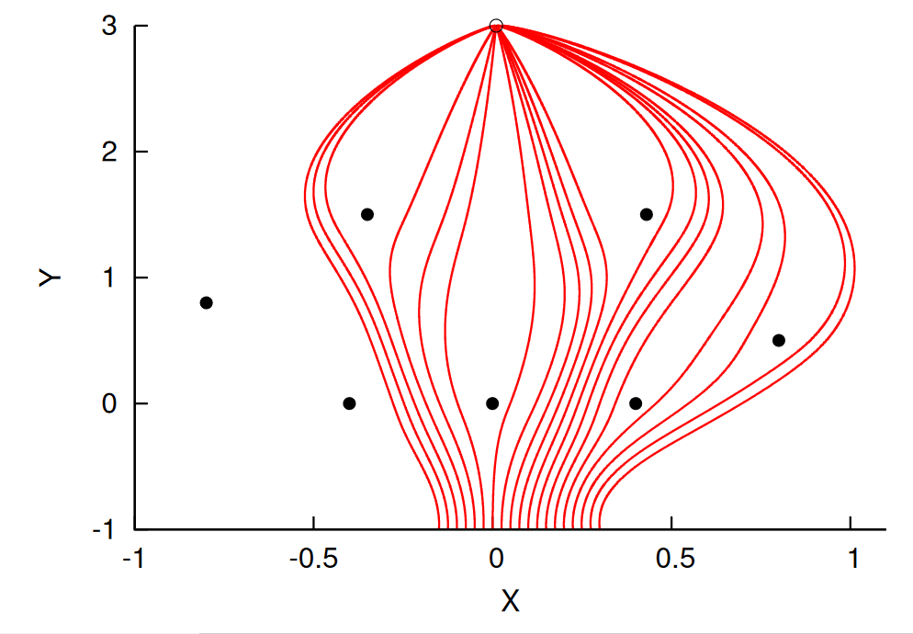
Applications to object avoidance
Features:
Give more natural trajectory motion
Time and location invariant
Adaptive to goal changes
Adaptive to moving obstacles
[2]

Slide 13
Design requirements
High refresh rate
Robust
Modular
Generic and adaptable
Notes:
High refresh rate to allow for reactive arm control
Robust code to be safe for use in human environments, causing no damage to the manipulator or its surroundings
Modular, to allow for easy implementation and modification
Generic and Adaptable, to allow for use with a large range of manipulators

Slide 14
Design choices
High Refresh rate:
Use C++
Consider operation speeds when programming
Using Eigen
Robust
Used unit test driven development
Significant time went into planning
Modular
Planning and Class diagrams used in designing
Package structure used in development
Generic and adaptable
Used interfaces
Modular design

Slide 15
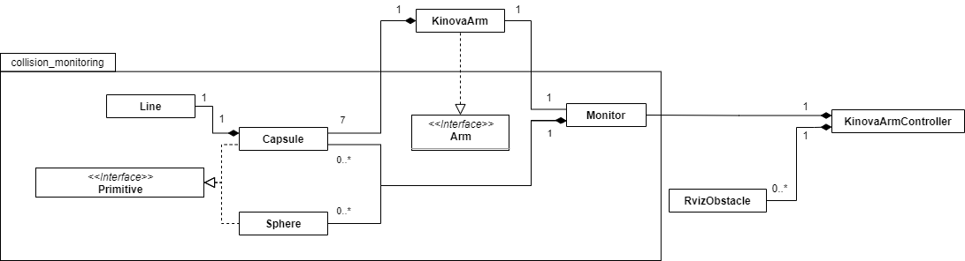
Implementation

Slide 16
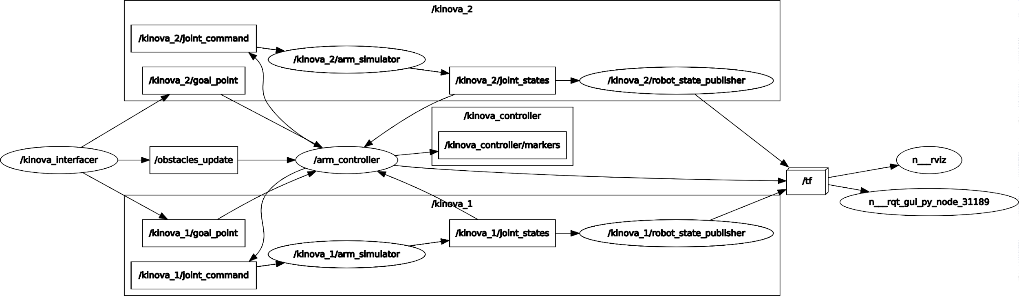
ROS Implementation

Slide 17
Testing and analysis
Collision monitoring library:
Theoretical refresh rate ~250Hz on Intel i5-7200U 2.5GHz running ubuntu 16.04
Operation | Time (seconds)
Initialise Arm and Monitor class | 0.00103831
Initialise Object and add to Monitor | 0.00000276
Update the arms position | 0.00012871
Calculate the distance to an obstacle | 0.00026022
Distance to the arms own links | 0.00199209

Slide 18
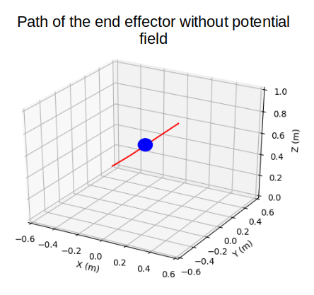
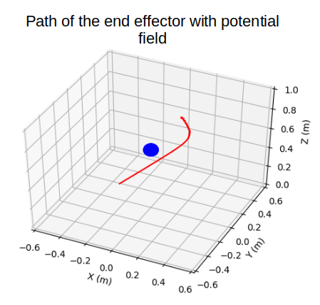
Testing and Analysis
Single Arm

Slide 19


Slide 20
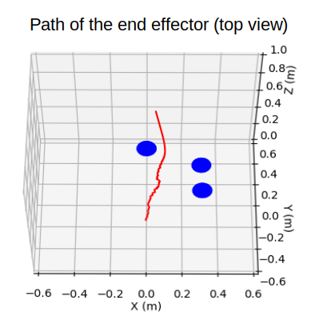
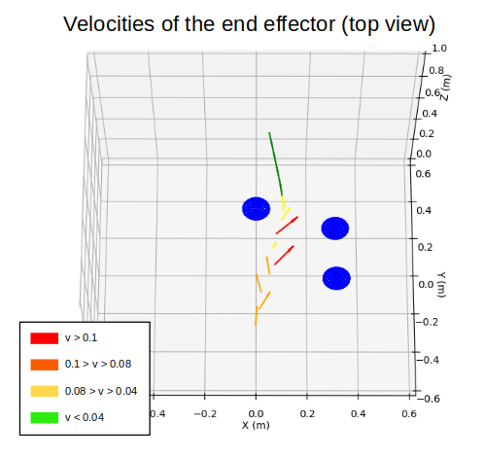
Testing and Analysis
Single Arm

Slide 21
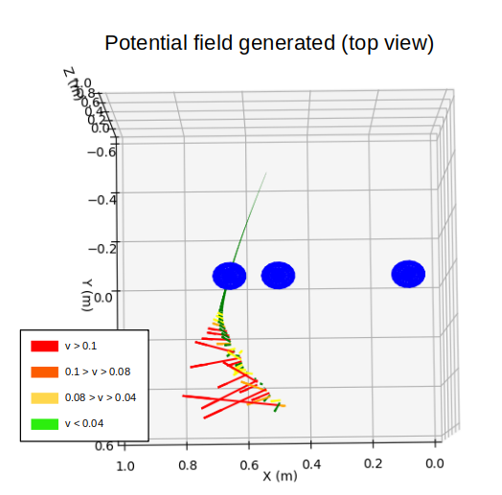
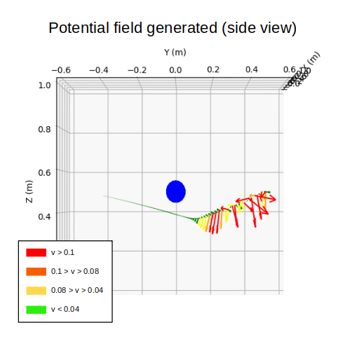
Testing and Analysis
Single Arm

Slide 22
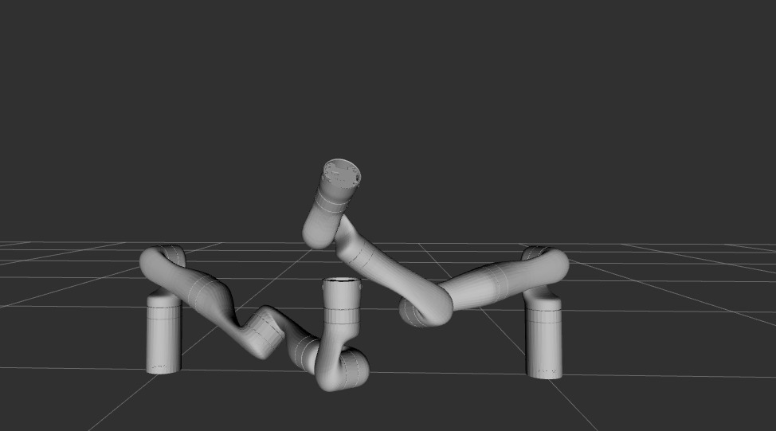
Testing and Analysis
Dual Arm

Slide 24
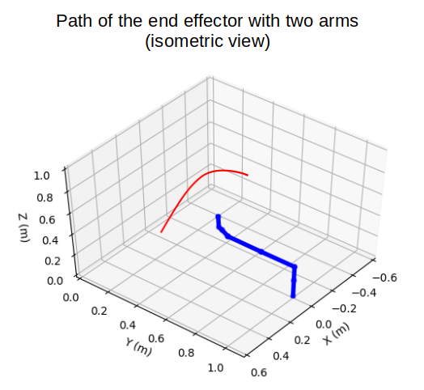
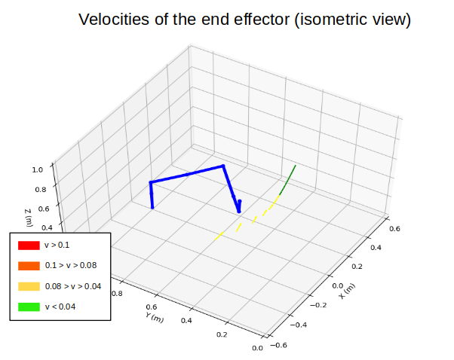
Testing and Analysis
Dual Arm

Slide 25
Conclusion
Achievements:
Successful integration of collision monitoring and avoidance techniques
Robust collision monitoring library
Successful implementation of potential field method with two manipulators
Improvements:
Optimisation of self collision monitoring
More shapes
Implementation of null-space control algorithm

Slide 26
References
[1] H. Hoffmann, P. Pastor, D.-H. Park, and S. Schaal, “Biologically-inspired dynamical systems for movement generation: Automatic real-time goal adaptation and obstacle avoidance,” in 2009 IEEE International Conference on Robotics and Automation, Kobe, May 2009, pp. 2587–2592, doi: 10.1109/ROBOT.2009.5152423.
[2] O. Khatib, “Real-Time Obstacle Avoidance for Manipulators and Mobile Robots” The International Journal of Robotics Research, vol.5, no. 1, pp. 90–98, Mar. 1986, doi: 10.1177/027836498600500106.

